Slide 1
Static Keyword

Slide 2
Static -Keyword
In Java, the keyword static is used for memory management primarily. It can be applied to variables, methods, blocks, and nested classes.

Slide 3
Static
Method
Variables
static
Block
class

Slide 4
Static Variables
Also known as class variables, static variables are shared among all instances of a class. They are initialized only once, at the start of the execution.
Syntax
static type variableName;
Example:static int count=0;

Slide 5
Objects share static variables
static int count=10;
Object1
Object2

Slide 6
Example
class Student{
int rollno;//instance variable
String name;
static String college =“LBRCE";//static variable
}
How to Use:
ClassName.varaibleName
Student.college

Slide 7
static method
If you apply static keyword with any method, it is known as static method.
A static method belongs to the class rather than the object of a class.
A static method can be invoked without the need for creating an instance of a class.
A static method can access static data member and can change the value of it.

Slide 8
class ClassName {
// Static method
static returnType methodName(parameters) {
// Method body
}
}

Slide 9
class MathOperations {
static int square(int number) {
return number * number;
}

Slide 10
public class Main {
public static void main(String[] args) {
// Calling static methods without creating an instance of the class
int squareOfFive = MathOperations.square(5);
// Printing the results
System.out.println("Square of 5: " + squareOfFive); // Output: Square of 5: 25
}
}

Slide 11
syntax for calling a static method
The syntax for calling a static method in Java is simple. Use the class name followed by a dot (.) and the method name. Here's the general syntax:
ClassName.methodName(arguments);

Slide 12
When can we access static variable
When a class is loaded by the virtual machine all the static variables and methods are available for use.
Hence we don’t need to create any instance of the class for using the static variables or methods.
Variables which don’t have static keyword in the definition are implicitly non static.

Slide 13
.Class variables and methods can be accessed using the class name followed by a dot and the name of the variable or method

Slide 14
Example
Class staticDemo{
public static int a = 100; // All instances of staticDemo have this variable as a common `
variable
public int b =2 ;
public static showA(){
System.out.println(“A is “+a);
}
}
Class execClass{
public static void main(String args[]){
staticDemo.a = 35; // when we use the class name, the class is loaded, direct access to a without any instance
staticDemo.b=22; // ERROR this is not valid for non static variable
staticDemo demo = new staticDemo();
demo.b = 200; // valid to set a value for a non static variable after creating an instance.
staticDemo.showA(); //prints 35
}
}

Slide 15
Static and Non-static
We can access static variables without creating an instance of the class
As they are already available at class loading time, we can use them in any of our non static methods.
We cannot use non static methods and variables without creating an instance of the class as they are bound to the instance of the class.
They are initialized by the constructor when we create the object using new operator.

Slide 16
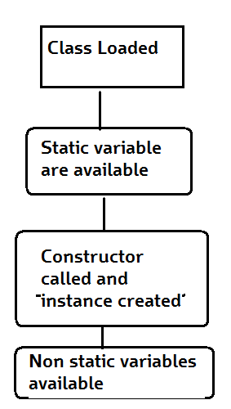
How it works
Basic Steps of how objects are created
Class is loaded by JVM
Static variable and methods are loaded and initialized and available for use
Constructor is called to instantiate the non static variables
Non static variables and methods are now available
As all the non static variable are available only after the constructor is called, there is a restriction on using non static variable in static methods.

Slide 17
Why do we need this
Static methods are identified to be mostly used when we are writing any utility methods.
We can also use static variables when sharing data.
When sharing data do keep in mind about multithreading can cause inconsistency in the value. (synchronize the variable)

Slide 18
Further Reading
http://docs.oracle.com/javase/tutorial/java/javaOO/classvars.html

